Slide 1
Conditional Formatting
By Rob Wallace, Caroline Sedell, Rachael Santos, Sarah Aguiar

Slide 2
What is it ?
Conditional formatting helps you answer specific questions about your data. You can apply conditional formatting to a cell range, an Excel table, or a PivotTable report.
There are important differences to understand when you use conditional formatting on a PivotTable report.

Slide 3
What are the Benefits
Conditional formatting helps to answer questions by making it easy to highlight interesting cells or ranges of cells, emphasize unusual values, and visualize data by using data bars, color scales, and icon sets.
A conditional format changes the appearance of a cell range based on a condition (or criteria). If the condition is true, the cell range is formatted based on that condition; if the conditional is false, the cell range is not formatted based on that condition

Slide 4
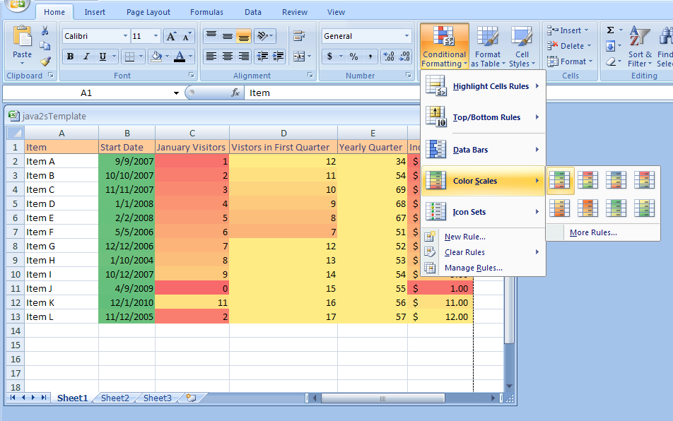
Color Scales
Color scales compare the relative magnitude of values in a cell range by applying colors from a two- or three-color set to your cells. The intensity of a cell’s color reflects the value’s tendency toward the top or bottom of the values in the range.

Slide 5
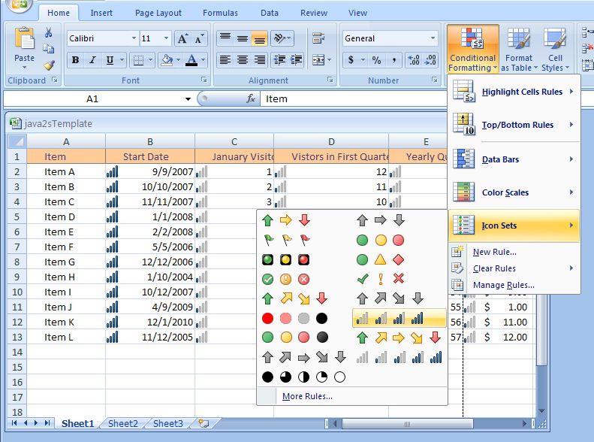
Icon Sets
Icon sets are collections of three, four, or five images that Office Excel 2007 displays when certain rules are met.

Slide 6
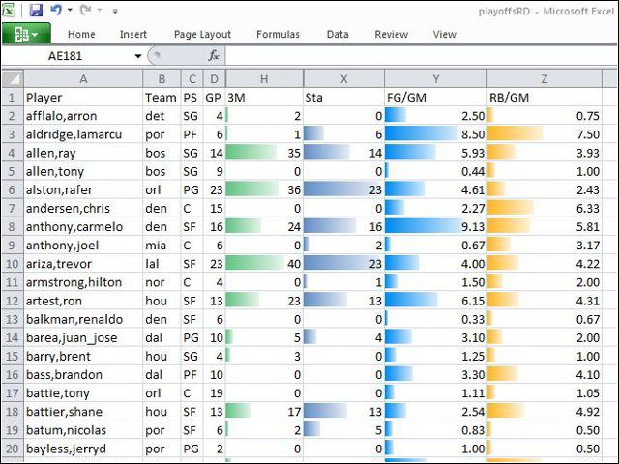
Data Bars
Data bars summarize the relative magnitude of values in a cell range by extending a band of color across the cell.

